Slide 1
DSIF9 Project 3 – Natural Language Processing
By: Ho Kit Fai
18th March 2023

Slide 2

Problem Statement
Let’s Play Game Forums Pte. Ltd. hosts the largest discussion forum for RagnarokOnline and Maplestory – the hottest game at the moment
Majority of the forum users are primary/secondary school kids that does not organize their discussions and some users are frustrated at the confusing game discussion, and unfortunately Let’s Play Game Forums did not separate the game discussions into subforums at the beginnning
Let’s Play Game Forums would like to leverage machine learning to classify the forum discussions in order to help the users understand which game they are discussing on
Cluttered Forum Posts
Organised Forum Posts

Slide 3
Data Science Process
Data Collection – Pushshift API on Reddit’s r/RagnarokOnline and r/Maplestory
Data Cleaning
Exploratory Data Analysis
Preprocessing
Modelling – combination of transformer (CountVectoriser & TFIDF) and estimator (Naïve Bayes & Logistic Regression)
Evaluation
Conclusion
Future Work

Slide 4




Data Science Process – Data Collection
Leverage existing Pushshift API to pull posts from r/RagnarokOnline and r/Maplestory, the loaded into a Pandas Dataframe to be further processed

Slide 5
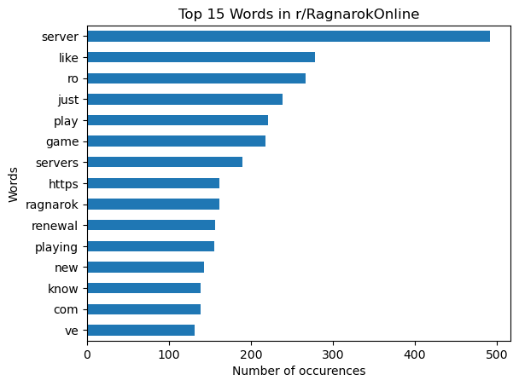
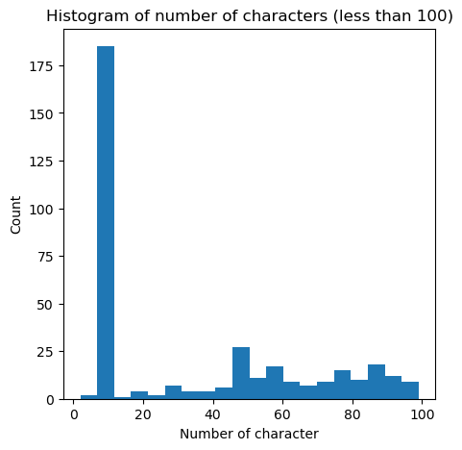
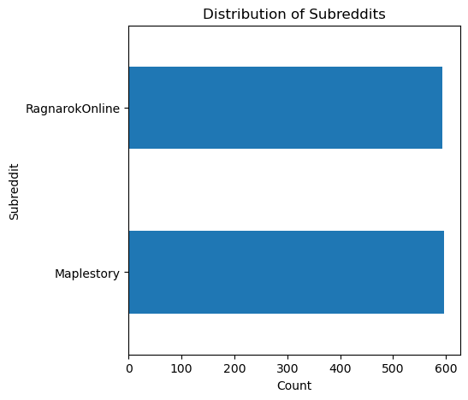
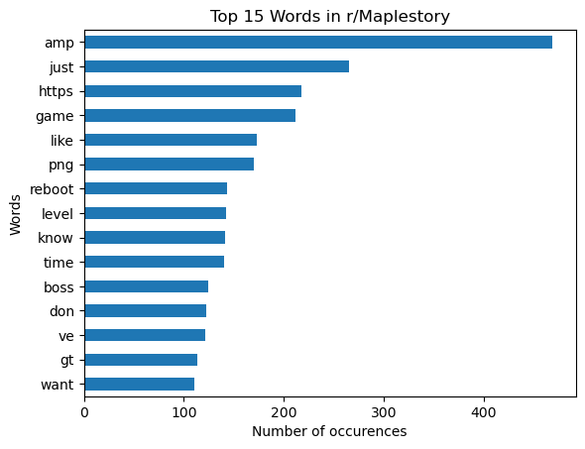
Data Science Process – Data Cleaning and Exploratory Data Analysis
Converted strings for main content (“selftext” column) into number of characters, then look out for anomalies
Checked distribution of subreddits post cleaning
Tokenised and lemmatized ”selftext” column and explored the top words
Notes:
Step 1: Sus out the funny post, turns out most of the ones with less than 20 chars are inflammatory/removed/deleted
Step 2: Check the distribution of subreddits after cleaning, pretty balanced
Step 3: Looked at the top words, only "game", "just", "https", "like” are common, no need to create special stop words

Slide 6
Data Science Process – Preprocessing, Modelling, and Evaluation
Mapped the subreddits into 0 and 1
Split data into training and testing
Used GridSearchCV (5 folds) to find best parameters for the below models
Accuracy is the main metric for evaluation. We would recommend Model 6.1 or 6.4 as they have a good accuracy score, and both models are computationally inexpensive
Model | Transformer | Estimator | Train Score | Test Score a.k.a. Acccuracy | Precision | Recall a.k.a. Sensitivity
6.1 | Count Vectoriser | Naive Bayes | 0.9900 | 0.9008 | 0.9115 | 0.9133
6.2 | TFIDF | Naive Bayes | 0.9787 | 0.8931 | 0.9144 | 0.9184
6.3 | Count Vectoriser | Logistic Regression | 0.9987 | 0.9059 | 0.8922 | 0.8878
6.4 | TFIDF | Logistic Regression | 1.000 | 0.916 | 0.8905 | 0.8827
Notes:
CountVectoriser and TFIDF only takes Series for X
Stratified (although not critical for a balanced set of data), 0.33
Dataset is balanced, so Accuracy is main metric.
Precision minimize false positive
Recall minimize false negative
Model 6.1 took 1.5 min for 3360 fits, which translates to 2240 fits/per min
Model 6.4 took 15 mins for 30240 fits, which translatest to 2016 fits/per min

Slide 7
Data Science Process – Some Observations
All models adopted max_df of 0.85, which means the transformers ignore terms that appear in more than 85% of the documents
All models adopted min_df of 2, which means the transformers includes terms that appears in at least 2 documents
Naive Bayes prefers transformers that adopts n_gram of (1, 2), which means 1~2 words are considered in the classification
Logistic Regression prefers n_gram of (1, 1)
All models performs best with "English" stop words

Slide 8
Data Science Process – Conclusion and Future Work
The Model 6.1 and Model 6.4 achived an accuracy of 90% and 92%, which is significantly better than the baseline model (around 50%, it's as good as flipping a coin).
The client is able to use the models developed to clean up their forums and classify the posts in the forum to help the forum achieve a better user experience.
The dataset used is only 1000 posts per subreddit, so the gridsearch work is manageable. We will consider using more subreddits of similar contents to create a better classification model at the expense of some increase in computational requirements
The client can consider creating subforums in their system for new and upcoming games in order to keep the forums organised from Day 1
The NLP model can be further extended to create forum tags to further subdivide and improve the topic search for the users

